Slide 1
Student Behaviour Analysis
Capstone Project Group 8
Archit Navadiya (0815897)
Dhrumil Patel (0813662)
Bhumit Navadiya (0812548)
Arbaz Shaikh (0823127)
Felix Saji (0803791)

Slide 2
TABLE OF CONTENTS
01
02
03
04
PROJECT OVERVIEW
METHODOLOGY
05
PROBLEM STATEMENT
ML IMPLEMENTATION
06
DATA EXPLORATION
NEXT STEPS & FUTURE WORK
07
NEXT STEPS & FUTURE WORK

Slide 3

PROJECT OVERVIEW
Main goal of the project is to analyze and enhance the Zekelman School of IT's facilities and student experience by assessing student satisfaction and identifying improvement areas in facilities and support services.
We are utilizing Microsoft Forms to conduct an online survey among all IT program students, covering topics such as program satisfaction, faculty interactions, facility usage, support services, and overall student experience. Power Automate and Azure will be used for automated data gathering process.

Slide 4




PROBLEM STATEMENT
This research delves into the encounters of students at Zekelman School of Information and Technology regarding demographics, housing, accessibility, work opportunities, and academic pursuits. The goal is to pinpoint obstacles, enhance support structures, and elevate overall contentment and achievement, ultimately leading to a deeper comprehension of student welfare.
Demographics
- program, country, age, gender, etc.
Accommodation & Convenience
- type of accommodation, rent, amenities
Employment & Scholastics
- status, average income, services provided by college

Slide 5

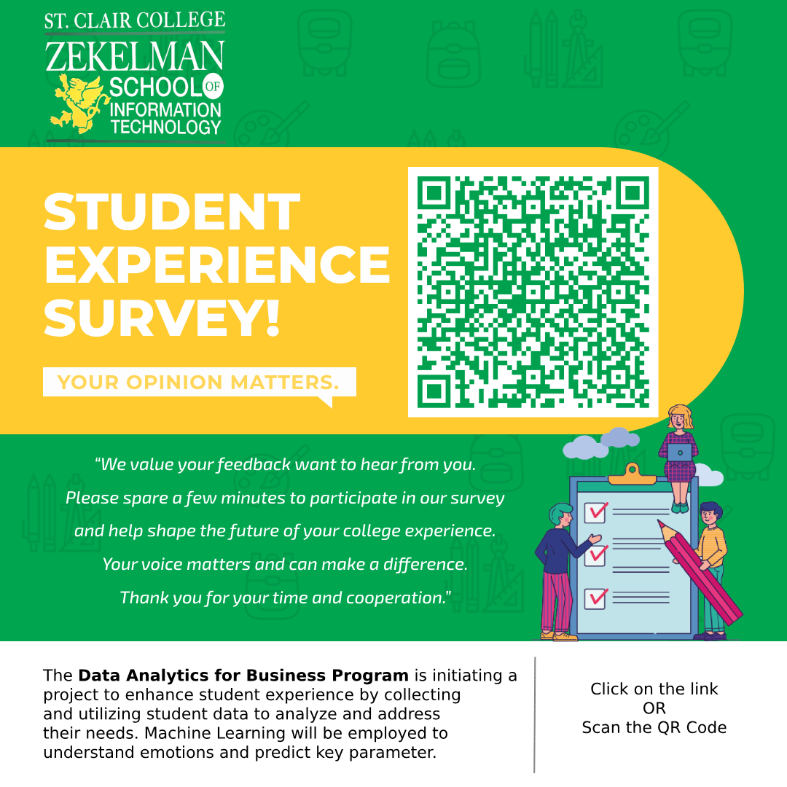
DATA EXPLORATION
01
02
03
Demographics Table | Accommodation Table | Academic Table
Contains personal characteristics data. Age Gender Education level Professional experience | Provides insights into housing situations. Accommodation type Rental prices Commute reliability | Focuses on academic statuses and experiences. Employment Status Workload expectation Feedback on services

Slide 6

METHODOLOGY
Survey Distribution: We distribute structured surveys covering demographics, accommodations, resource preferences, and satisfaction levels to students across both campuses of the Zekelman School of Information Technology.
Data Collection: Comprehensive data is gathered through surveys and stored securely in Azure SQL Database with the help of Power Automate.
Data Cleaning: To clean data based on the scheduled time we used a data factory that will fetch new responses from the database, clean it, and store them back into the new database
Analytics Approach: We utilize descriptive analytics for initial insights and predictive analytics for forecasting future behaviors, integrating quantitative and qualitative approaches to derive actionable insights for enhancing student satisfaction and academic success within the college.

Slide 7
ML IMPLEMENTATION
Statistical Analysis: Through hypothesis testing, we examine correlations between demographic features (gender, age group, experience, education level, and course) and Academic and Accommodation Scores to understand their influence on student satisfaction and performance.
Predictive Modeling: We utilize decision tree regression, Support Vector Regression, Gradient Boosting Regression, Random Forest regression, and Neural Network models to forecast the Overall Academic Score and Overall Accommodation Score.
NLP Analysis: Employing NLP, we analyze student feedback to identify preferences and dislikes, aiding in targeted improvements for academic and accommodation experiences.

Slide 8
NEXT STEPS
Power BI Visualization: Utilize Power BI to craft interactive dashboards and visuals, offering insights into student demographics, study habits, and satisfaction levels.
Statistical Analysis: Employ Python for thorough statistical examination, covering descriptive and logical analyses to uncover patterns and correlations within the data.
Implementation of Machine Learning Models:
Develop predictive models using Python's machine learning libraries, aiming to forecast student academic performance. Experiment with various algorithms, assess model performance and refine for optimal accuracy.`

Slide 9

FUTURE WORK
This project was done by our seniors who examined the conduct of St. Clair College's downtown campus's Data Analytics for Business Program students.
We are expanding the project to include all students at the Zekelman School of Information Technology on both campuses with our research.
Our future steps involve incorporating all programs offered by St. Clair College, not just limited to Windsor. We aim to expand our research to include campuses in additional cities, enabling a comprehensive understanding of students' needs and preferences across various programs and locations.

Slide 10
THANK YOU

